Slide 1
Amazon Product & Review Analysis (Office products and CDs & Vinyl Dataset)

Slide 2

BRIEF OVER-VIEW OF THE COMPANY
The year was 1994 when Jeff Bezos launched Amazon from his garage. In 1995.
The first product launched by Amazon was a book in 50 states and in 45 countries within 30 days.
The Amazon name has become synonymous with online shopping and continues to grow by developing new products, acquisitions, and numerous service offerings to enlarge the customer base.
Nowadays, almost 150.6 million people turn to the Amazon app for most everything.

Slide 3
OBJECTIVE
To develop an automated system to analyse and monitor an enormous number of reviews.
By monitoring the entire review history, analyse tone, language, keywords, and trends over time to provide valuable insights that increase the success rate of existing and new products and marketing campaigns.
Inventory Optimization and Demand Forecasting (Time Series Analysis)
SCENARIO 2
Sentiment analysis of the review text and forecasting (Sentiment Analysis & Time series )
Forecast what kind of products could be in demand (Clustering Model)
Customer Clustering (Clustering Models)
SCENARIO 1
DATA SOURCE

Slide 4

BUSINESS QUESTIONS WHICH WILL BE ANSWERED
How are reviews distributed among three types of sentiments i.e. Positive, Negative or Neutral?
How many customers are loyal customers and are they satisfied with amazon products ?
Whether review has direct relationship with the revenue generated?
Which are best and worst performing products on amazon ? And highly recommended products
Which are highly demanded Products on Amazon?
What is the customer retention trend over the years
What is the revenue trend since 1997? Special attention to the main categories i.e. Office products and CDs & Vinyl

Slide 5
BRIEF OVER-VIEW OF THE DATASET
META DATA DICTIONARY
‘title’
‘brand’
‘rank’
‘main_cat’
‘price’
‘asin’
‘category’
REVIEW DATA DICTIONARY
‘reviewerID’
‘reviewTime’
‘verified’
‘reviewText’:
‘overall’
‘summary’
‘asin’
RATING DATA DICTIONARY
‘rating
‘reviewerID’
‘date’
‘asin’

Slide 6
TOOLS AND TECHNIQUES USED FOR DATA CLEANING
Null Value Treatment
Noise Value Treatment
Imputation by ways of libraries
Imputation by ways of Conditional Loops
User defined functions for cleaning and imputation
Imputation

Slide 7
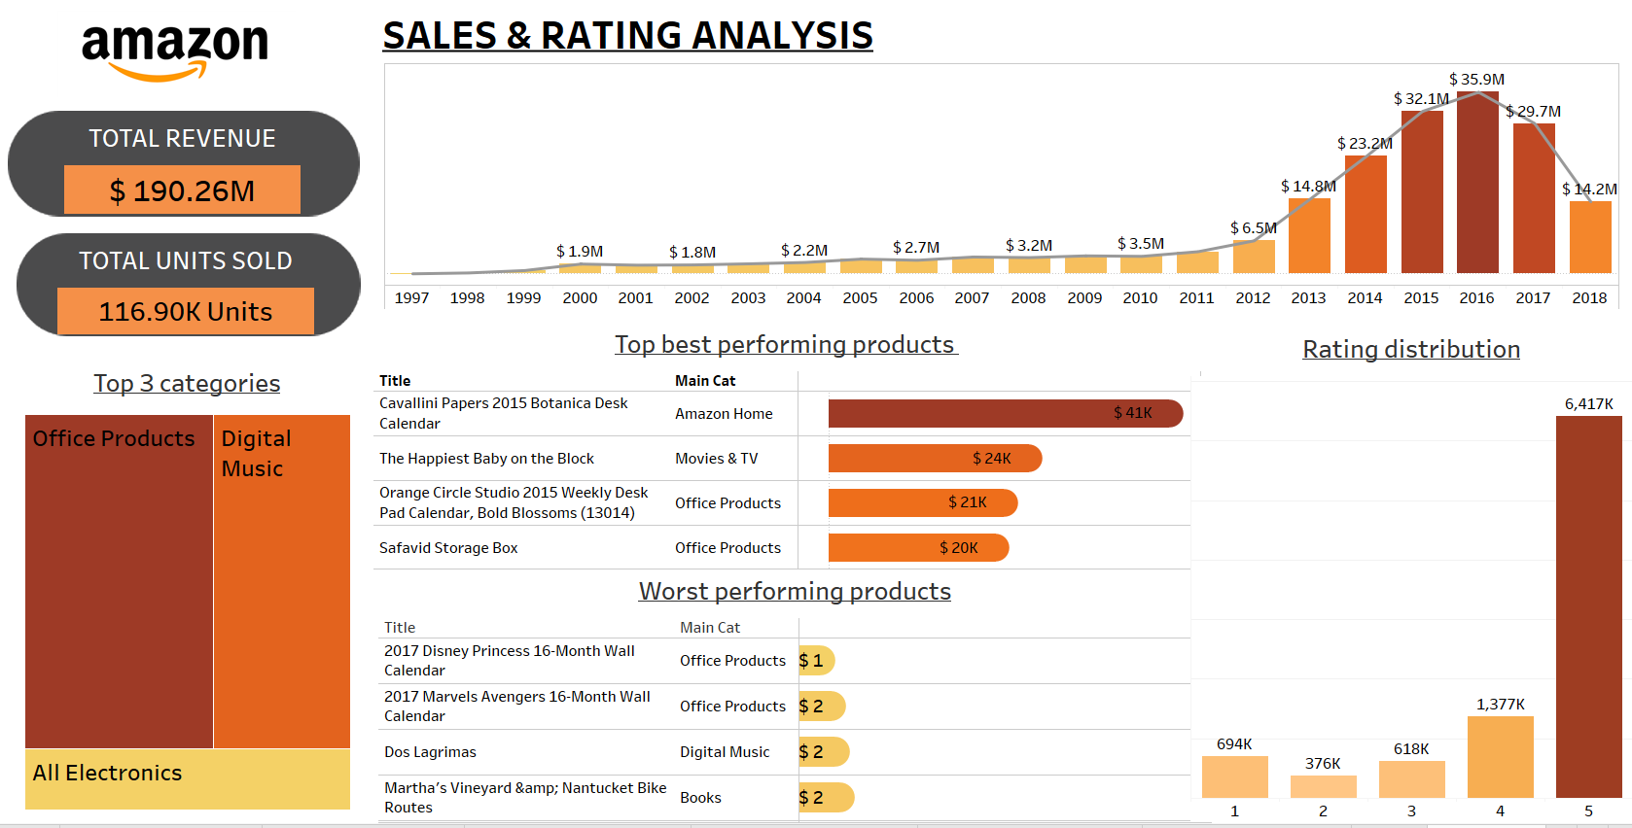
VISUAL ANALYSIS OF THE RATING DATA
Dashboard

Slide 8
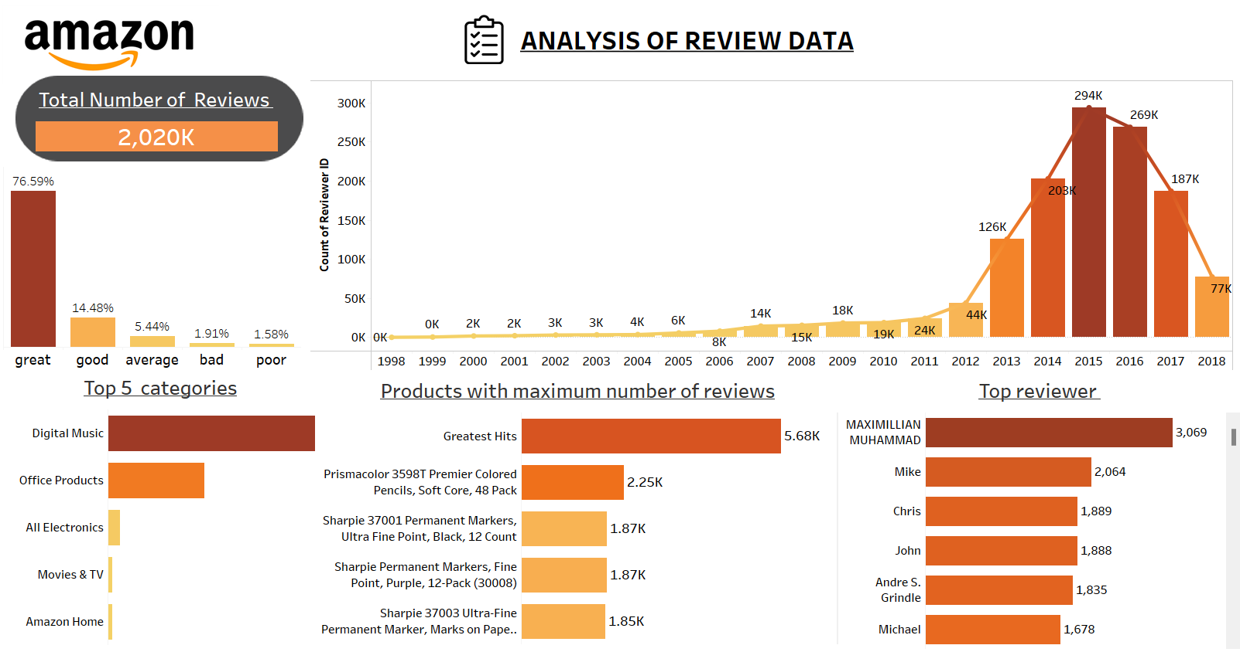
VISUAL ANALYSIS OF THE REVIEW DATA
Dashboard

Slide 9
BUSINESS PURPOSE OF SENTIMENT ANALYSIS
SENTIMENT ANALYSIS OF REVIEW TEXT
OBJECTIVE : To create a Model for sentiment analysis of reviews posted by the customers and classify the reviews in three categories of Positive, Neutral and Negative.
Customer Retention
To know what is the satisfaction level of individual customers when they shop from Amazon
Product Development
To know which product is loved or hated by the customer. This will result in the better product development and demand forecast.
VaderSentiment vs Textblob

Slide 10
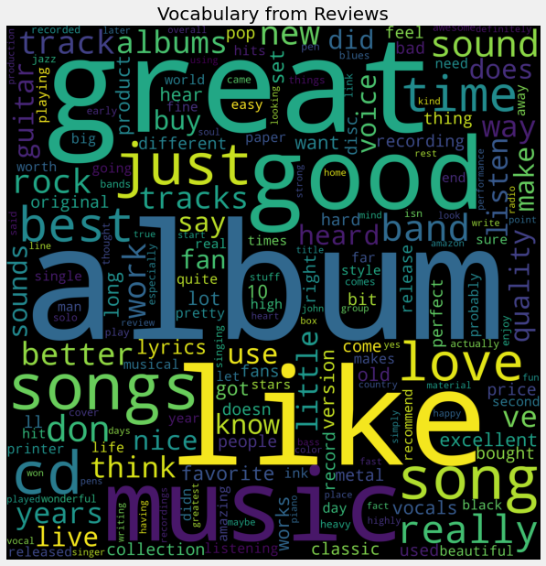
PRELIMINARY ANALYSIS ON REVIEWTEXT
Words like music, songs, album, band shows that there are more reviews for CDs & Vinyl Data
Words like Great, Good, Like, Love denotes positive sentiments

Slide 11
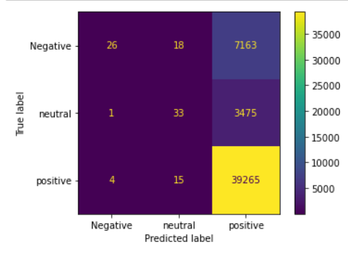
Model 1 - MultinomialNB classifier Baseline TF-IDF Vectorizer
Drawback - Low accuracy in predicting
Negative and neutral sentiments

Slide 12
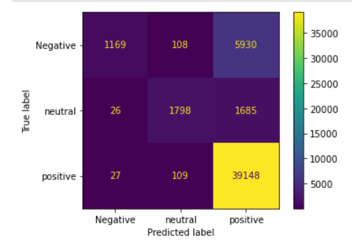


Model 2 - Random Forest classifier Baseline TF-IDF Vectorizer
Drawback – Comparatively higher accuracy in prediction than model 1 but overall low accuracy in predicting Negative and neutral sentiments

Slide 13
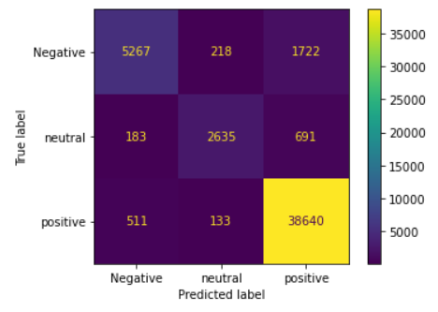
Model – 3 Logistic Regression with OVR Baseline TF-IDF Vectorizer
From the three models Model -3 has the highest number of correct predictions across all sentiments, hence this model shall be used for sentiment predictions in future.

Slide 14
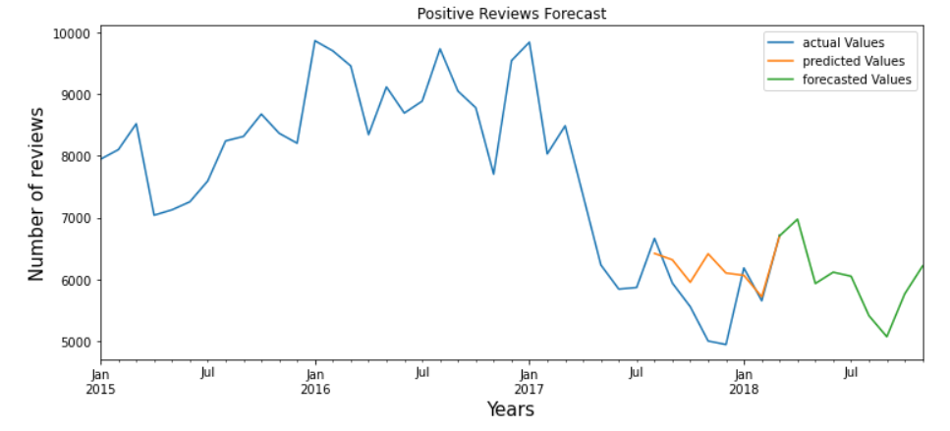
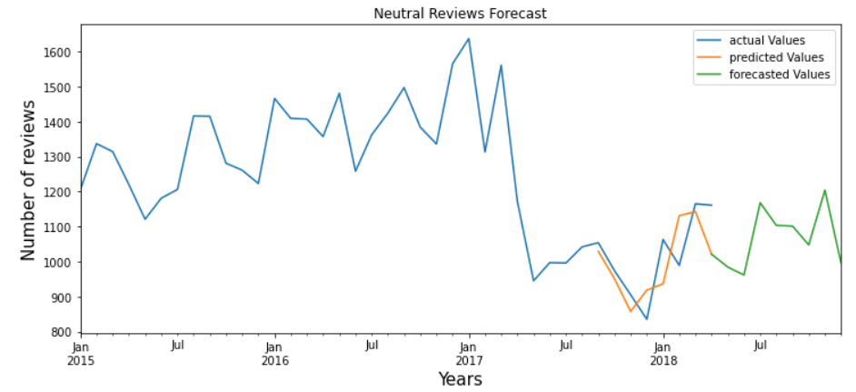
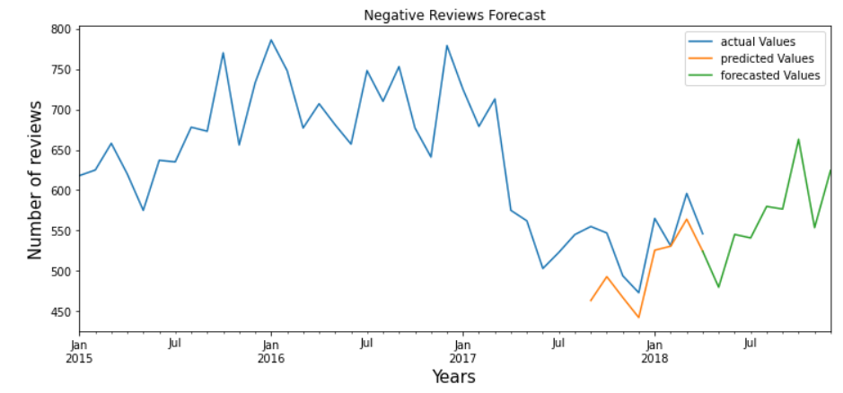
TIME SERIES ANALYSIS FOR FORECASTING FUTURE SENTIMENTS

Slide 15
OBJECTIVE: To find different types of customers present in Amazon
CLUSTERING OF CUSTOMERS
Criteria for clustering:
The overall sentiment of a person as customer
Number of orders placed by a customer
The total amount spent by the customer
For how long a person has been Amazons customer

Slide 16
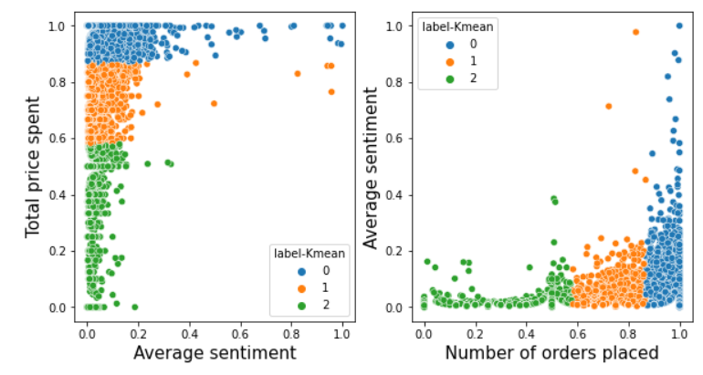
Label | Average Sentiment | Total price spent | Number of orders
0 | Positive | Low to high | Low to high
1 | Neutral | Low to Mid | Low to Mid
2 | Negative | Low | Low
List of customers : SATISFIED NEUTRAL NOT SATISFIED

Slide 17
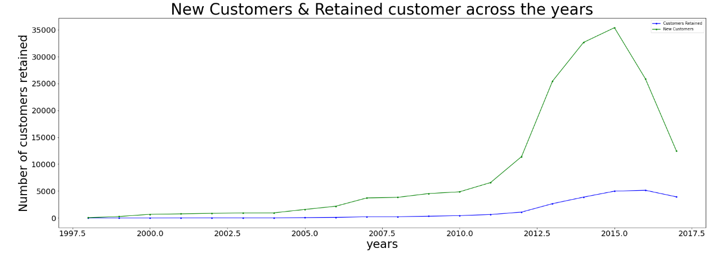
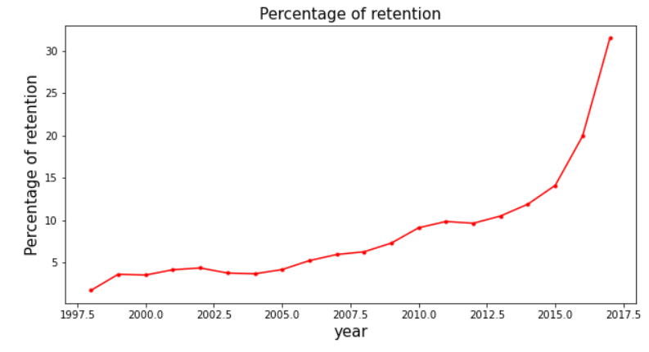




NEW CUSTOMERS & CUSTOMER RETENTION FORECASTING
New customers earned by Amazon each year
Out of new customers how many customers were retained till 2018
Customer retention TABLE

Slide 18
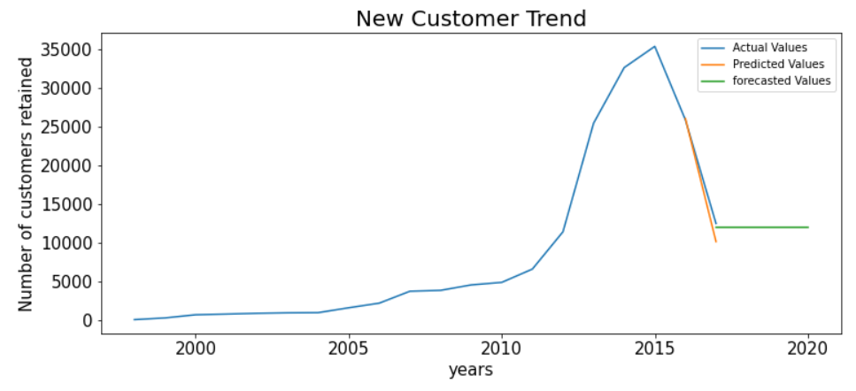
NEW CUSTOMERS FORECASTING
Trend of new customers is likely to become stagnant for next 3 years
Customer retention TABLE

Slide 19
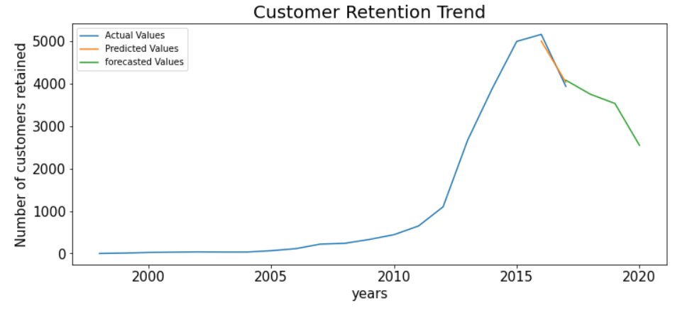
CUSTOMERS RETENTION FORECASTING
Trend of customers retention is likely to fall for next 3 years

Slide 20
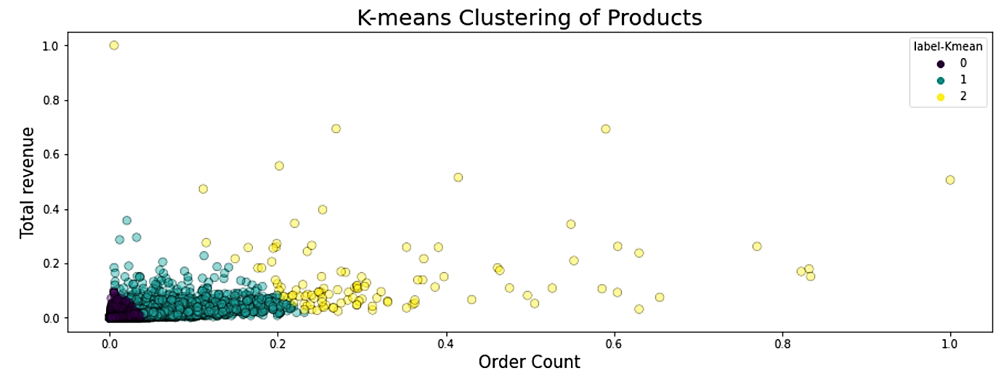
CLUSTERING OF PRODUCTS
OBJECTIVE: To find out which products are highly demanded for inventory optimization
Number of orders placed
Label 0 Low demanded Label 1 Average demanded Label 2 High demanded

Slide 21
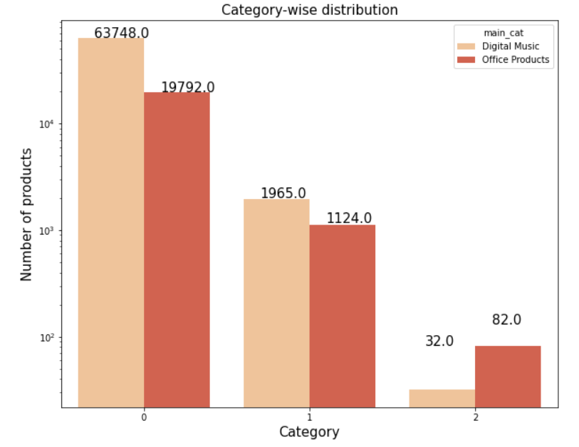
Distribution of categories in demand classes
Features of each demand category
Demand | Label | Quantity sold | Total_sales (revenue)
Low | 0 | 1-95 units | $0.05 - $9,599
Medium | 1 | 13-521 units | $37 - $34,866
High | 2 | 251-2246 units | $2,370 - $97,684
Low Average High
Demand

Slide 22
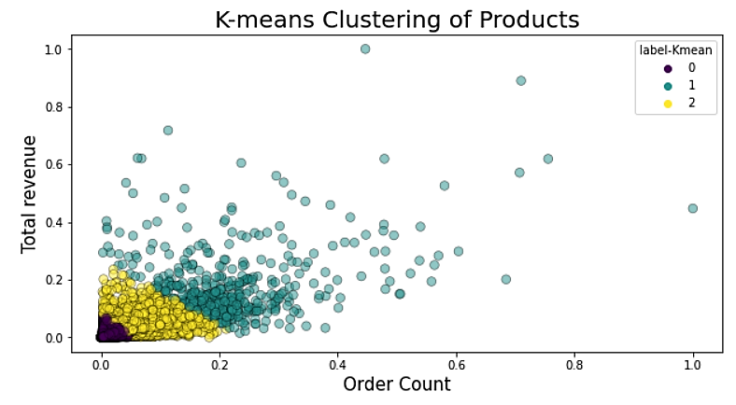
DIGITAL MUSIC
Top 5 products
ProductID | Title | Total orders | Total revenue
B00L98V4UW | 25 | 1183 | $10,635
B000002IQ1 | Led Zeppelin | 894 | $14,728
B000VZK7T8 | Nevermind | 840 | $21,176
B0000025H6 | The Wall | 810 | $4,787
B000002H98 | Metallica | 715 | $7099
HIGHLY DEMANDED PRODUCTS DIGITAL MUSIC DATA
Quantity ordered

Slide 23
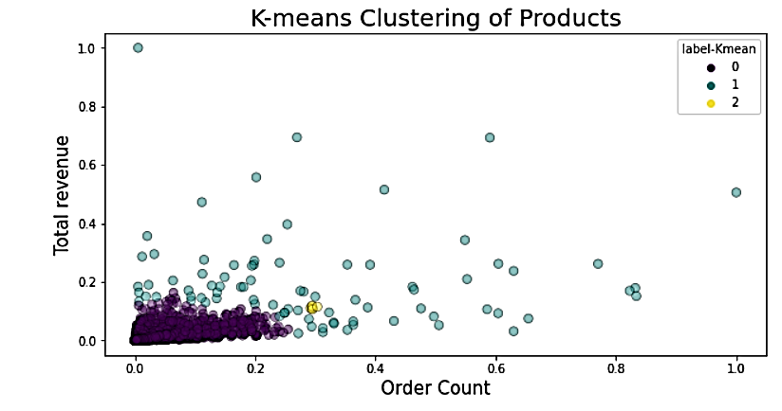
OFFICE PRODUCTS
Top 5 products
ProductID | Title | Total orders | Total revenue
B00006IEEV | Prismacolor 3598T | 2246 | $49,412
B00A89YZ6S | Sharpie 37001 | 1873 | $14,815
B00006IFEU | Sharpie Permanent marker | 1869 | $21,176
B00006IFI5 | Sharpie 37003 Ultra-Fine | 1848 | $17,512
B00006JNJD | Pilot G2 Retractable Premium Gel Ink | 1730 | $16,595
Quantity ordered
HIGHLY DEMANDED PRODUCTS
OFFICE PRODUCT CATEGORY

Slide 24
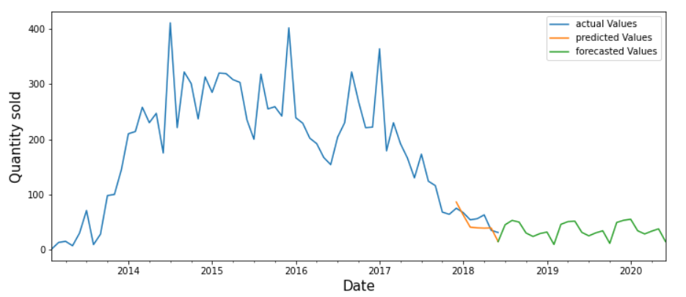
FORECASTING THE DEMAND OF A PRODUCT
Using time Series analysis for demand forecast of the top selling product of office product
Product ID : B00006IEEV Product title – “Aylio Comfort Seat Cushion”
Main Category: Office Product

Slide 25
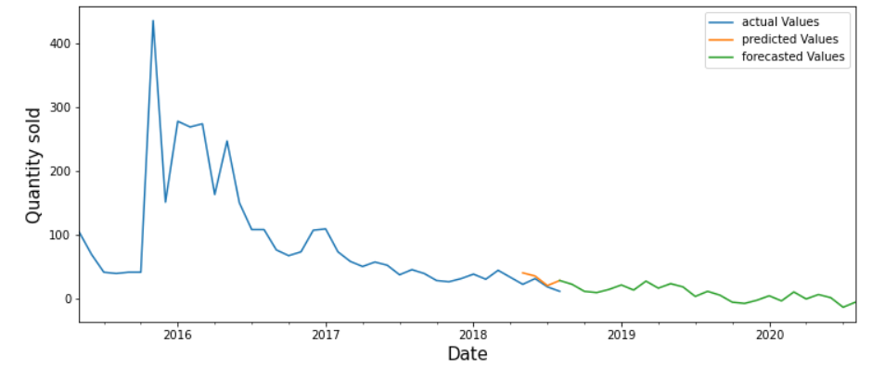
Product ID : B00SWBLS3C Product title – “Traveller”
Main Category: Digital Music

Slide 26
FINAL CONCLUSIONS ON ALL THE MODELS
Fall in positive reviews for next 12 months
Rise in negative reviews for next 12 months
Fall in customer retention for the next 3 years
PRODUCT CLUSTERING:
High demanded products
Average demanded products
Low demanded products
CUSTOMER CLUSTERING : (Out of 1.78 Lakh customers)
1.24 Lakh - Happy customers (SATISFIED)
43.2 Thousand - Average satisfaction (NEUTRAL)
11.1 Thousand - Not Happy (NOT SATISFIED )
WORKING CODE

Slide 27
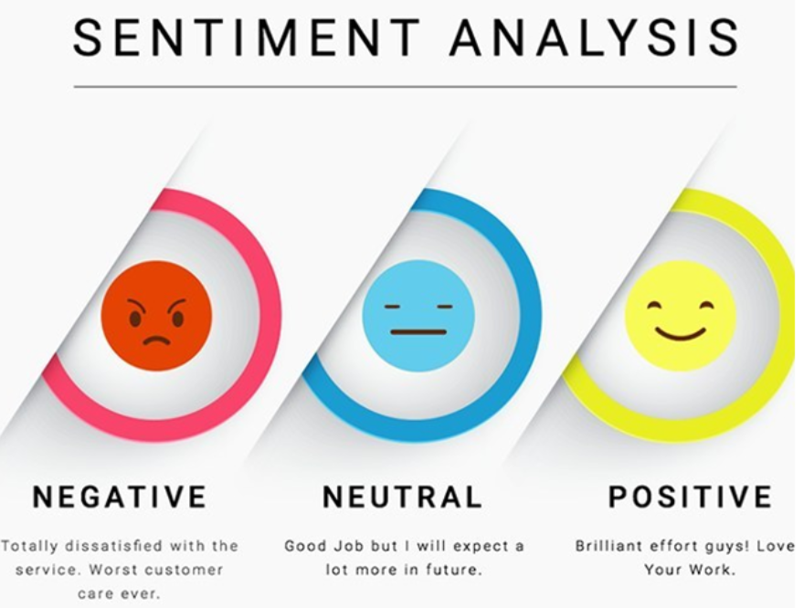
So what are your sentiments about the project ?
THANK YOU !!
Presented by :
Ankit Gurung | Apoorva Mishra | Zeeshaan Khan

